Slide 1



NUMERICAL INVESTIGATION ON DIFFERENT NANOFLUIDS MIXED CONVECTION IN TRIANGULAR DUCTS HEATED BY A UNIFORM HEAT FLUX
PRESENTED BY:
Sai Praneeth 711956
Srikar 711928
Sai Ganesh 711919
Yuvaraj 711961
SUPERVISOR
Dr. Santhosh kumar
Associate Dean,
Dept. of Mechanical Engineering

Slide 2
Introduction
Heat Transfer rate is an important criteria for proper functioning of machinery in industrial and research applications.
Heat transfer enhancement technology plays a very important role in designing heating and cooling equipment.
In order to increase the transfer of heat these thermal devices implement circular or non circular ducts filled fluid for convective heat transfer.
The performance of these ducts can be increased in two different ways.
One of them is by changing surface shape or surface area. And another way is by using a nano particle infused working fluid in ducts.

Slide 3
Introduction
In our project , we consider a equilateral triangular cross sectioned duct and we used pure water H₂O as base fluid and 3 different nano particles Al₂O₃ , SiO₂ and TiO₂.
We evaluate and compare their thermal features and fluid dynamic with different Richardson number values and different nano particle volume concentrations.
We are trying to improve the heating transfer properties in triangular duct by using various nanofluids.
Here we are using aluminum oxide-water, titanium oxide-water, silicon oxide-water based nanofluids.
A uniform heat flux is provide for each wall of ducts and particle size of nanofluid is equal to 30nm.

Slide 4
Applications:
Heat Exchangers.( Heat exchangers are used more often to dissipate heat )
Laser cooling
Cooling techniques
Thermal reservoirs
Usage of Boilers

Slide 5
Literature Review:
Authors | Flow passage | Type of Nanofluid | Outcomes
Heris, S. Z., Esfahany, M. N., & Etemad, G. (2006). | circular tube | CuO/water nanofluid | Both theoretical and experimental results indicate that heat-transfer coefficients increase with nanoparticle concentration as well as the Peclet number.
Edalati, Z., Zeinali Heris, S., & Noie, S. H. (2012) | Equilateral triangular duct | CuO/water nanofluid | The heat transfer increases with the nanofluid volume concentration as well as the Peclet number, a 41% enhancement in the convective heat transfer coefficient for a 0.8% CuO/water nanofluid can be seen when compared to pure water.
Manca, O., Nardini, S., Ricci, D., & Tamburrino, S. (2012) | Equilateral triangular duct | Al₂O₃/water nanofluid | There is a increase of average convective heat transfer coefficient and Nusselt number for increasing values of Richardson number and particle concentration, also wall shear stress and required pumping power profiles grow significantly.

Slide 6
Literature Review:
Authors | Flow passage | Type of Nanofluid | Outcomes
Mansour, R. B., Galanis, N., & Nguyen, C. T. (2011). | Inclined copper tube | Al₂O₃/water nanofluid | They developed correlations to calculate the Nusselt number in fully developed region for horizontal and vertical tubes. a higher particle volume concentration induces a decrease of the Nusselt number for the horizontal inclination. On the other hand, for the vertical one, the Nusselt number remains nearly constant with an increase of particle volume concentration from 0 to 4%.
Heris, S. Z., Edalati, Z., Noie, S. H., & Mahian, O. (2014). | Equilateral triangular duct | Al₂O₃/water nanofluid | The heat transfer enhancement increases with increases in the nanofluid volume concentration and Peclet number.

Slide 7
Literature review:
Here we use suspended solid nanoparticles in the working fluids(water). In this paper a numerical investigation on laminar mixed convection with Al₂O₃ /water based nanofluids in a triangular channel is presented.
A uniform and constant heat flux on the channel surfaces is assumed and the single-phase model approach has been employed in order to describe the nanofluid behaviour.
The analysis has been performed in the steady state regime for particle size in nanofluids equal to 30 nm. The CFD code Fluent has been employed in order to solve the three-dimensional numerical model and different Richardson
Walls are heated at uniform and constant heat flux, depending on Richardson number Al₂O₃ /water based nanofluids at volume concentrations equal to 0%, 1%, 2% and 4%. Reynolds number is set to 100 while Richardson numbers range from 0 to 5.

Slide 8
Literature Review conclusions:
The single-phase model was adopted in order to analyze the behaviour of nanofluids as working fluids and thermo-physical properties were evaluated by means of reduction equations.
Nanofluids significantly increase the convective heat transfer coefficients, in particular, at high particle concentration.
Moreover, heat transfer coefficients grow as Richardson number increases and this is more significant at low Richardson number values.
The highest enhancement is evaluated for = 4% and the average convective heat transfer coefficient values are 1.42, 2.00, 2.18 and 2.40 times greater than the ones obtained for the reference case, at Ri = 0.1, 1, 2 and 5, respectively.

Slide 9
Literature Review conclusions:
However, the disadvantages linked to the use of nanofluids are represented by the increase of the wall shear stress and the required pumping power, in particular, at high particle concentrations.
An average increase of about 32% in terms of wall shear stress is evaluated in comparison with the pure water cases.
Furthermore, the pumping power ratio, referred to the pure water cases in forced convection, is equal to 1.25, 1.60 and 2.85 for = 1%, 2% and 4%, respectively.

Slide 10
Objectives:
We are trying to compare the thermal properties variations for different nanofluids used in triangular duct.
Observing how thermo-physical and thermal properties of nanofluids are varying with volume concentrations.
Trying to find optimal nanofluid for enhanced heat transfer.

Slide 11
Methodology:
The study has been done on steady state and fully developed regime flow.
The numerical analysis on three dimensional triangular duct model is solved by computational fluid dynamic(CFC) code “Ansys Fluent” for varying volume concentrations, varying Richardson numbers and for different nanofluids.
The flow is steady state, incompressible, laminar flow with constant temperature and we assumed Boussinesq approximation.
The single-phase model approach is employed for nanofluids. A second-order upward scheme is employed for energy and momentum equations.

Slide 12
Methodology:
The ‘SIMPLE’ coupling scheme was employed to couple pressure and velocity.
A convergence criteria of 10^(-4), 10^(-5)and 10^(-8) were assumed for the residuals of continuity, velocity components and energy respectively.
No-slip condition was applied on duct walls, and temperature and density variations are ignored along the duct.

Slide 13
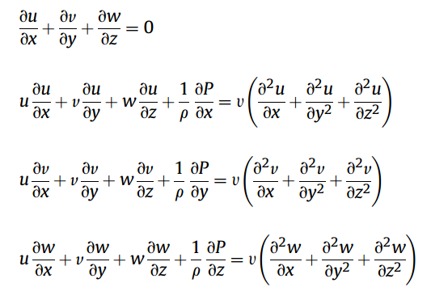
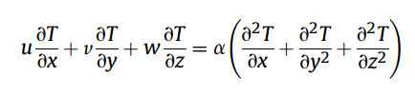
Numerical Methodology:
The governing equations of continuity, momentum and energy equations in 3-D form were solved by means of FLUENT code.
Continuity Equation
Momentum Equation
Energy Equation

Slide 14
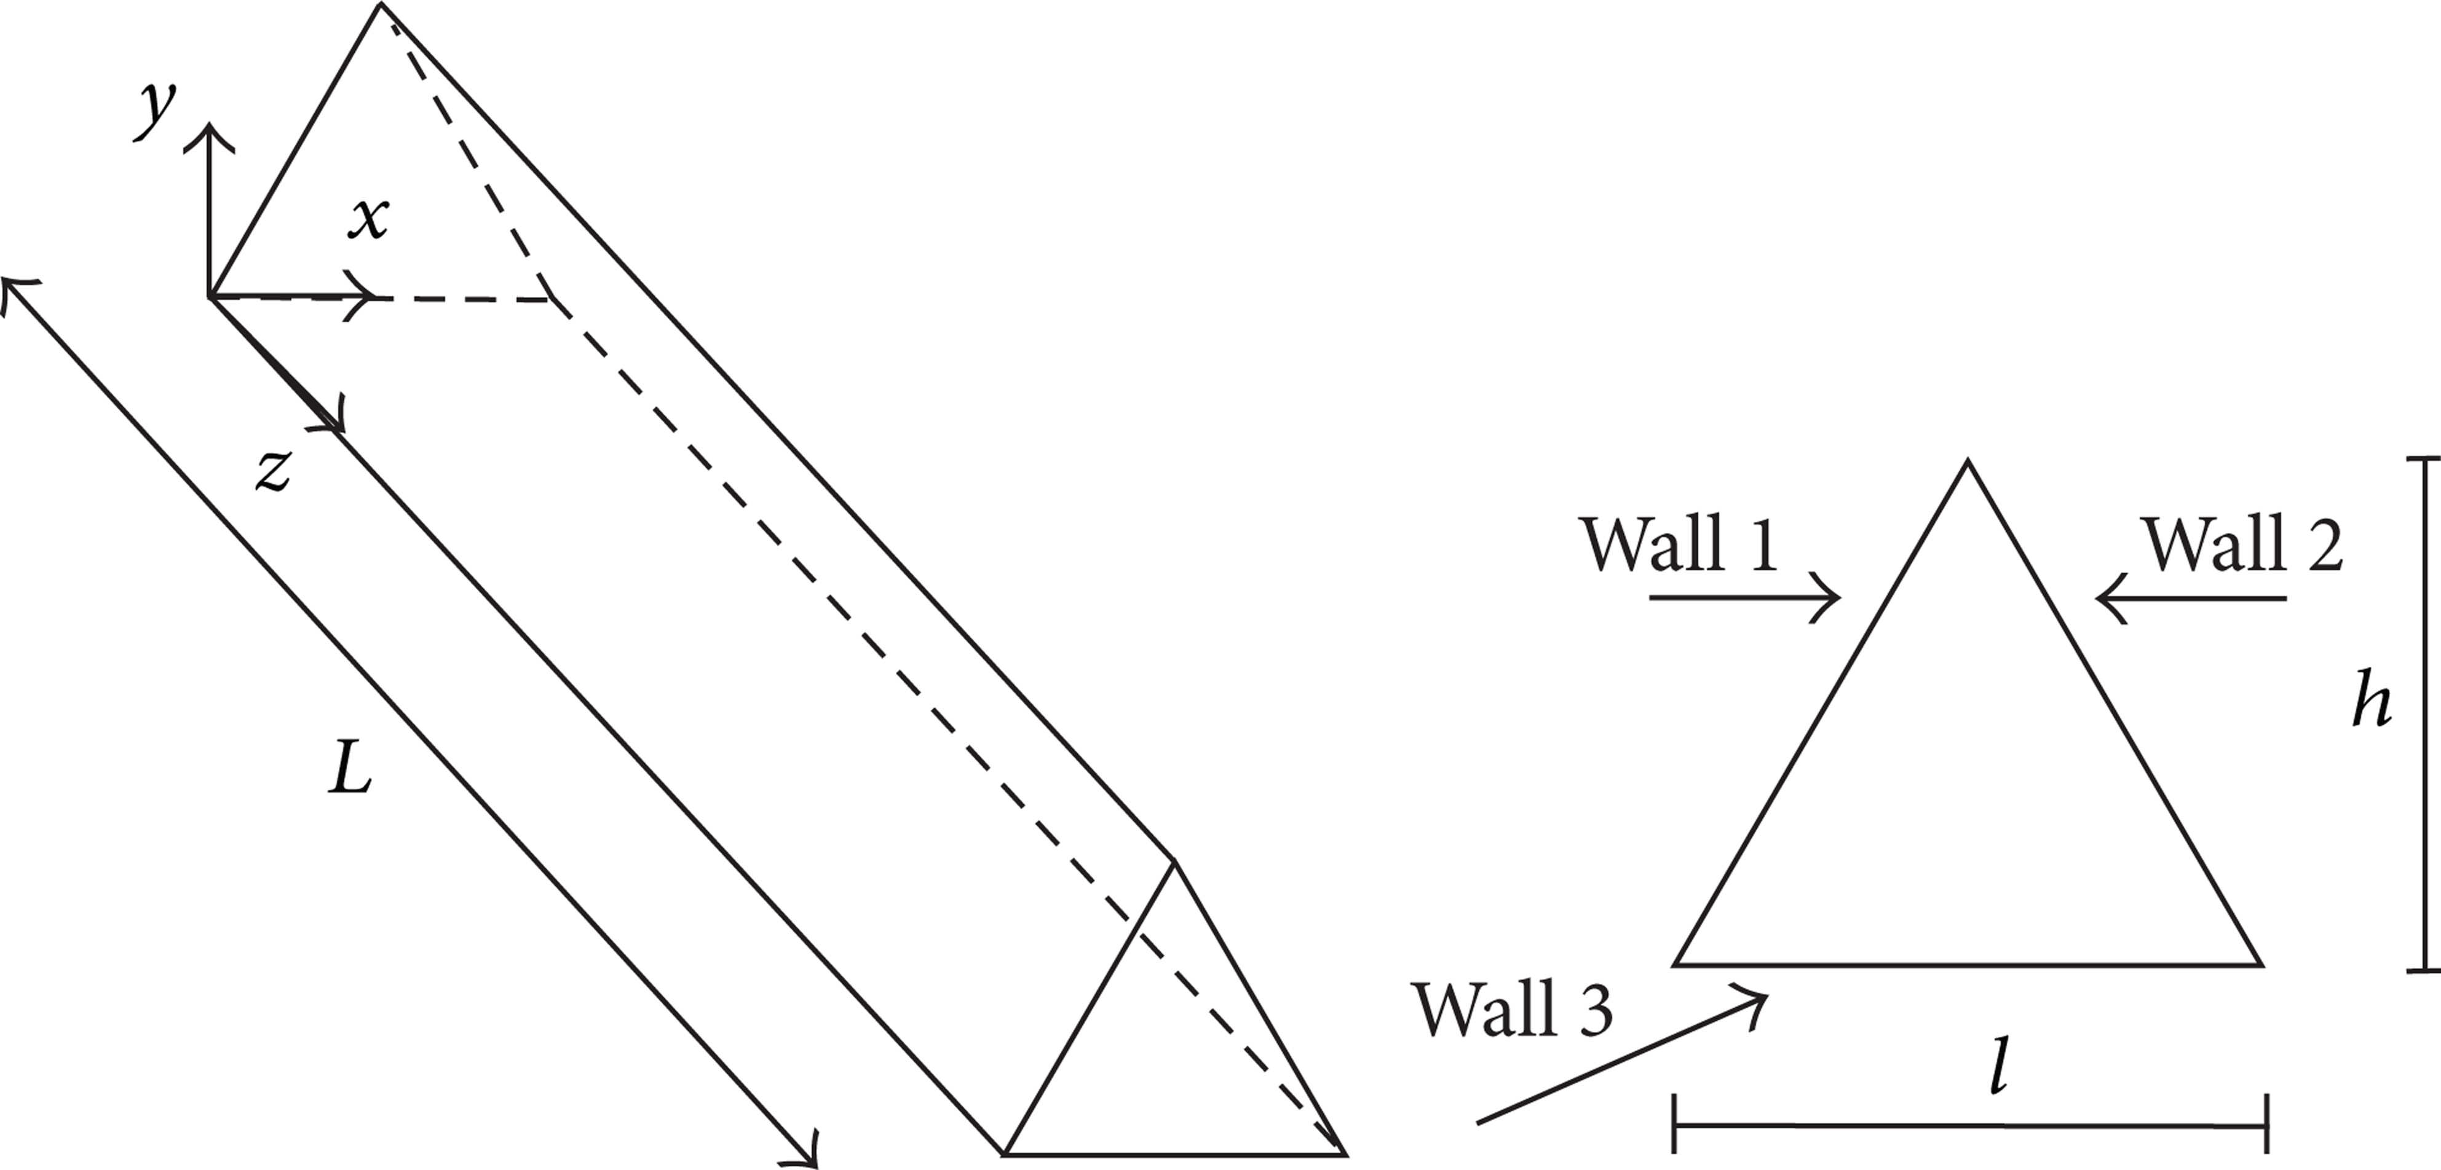
Geometrical description
A three-dimensional duct with an equilateral triangular cross section is investigated as shown in figure-1.
According to figure-1, the overall length L is 2.0 m, whereas the internal edge l is 0.017m.The hydraulic diameter, dh = 4A/Ph, is therefore equal to 0.01 m.
Figure-1: Equilateral triangular duct and its cross-sectional view

Slide 15
Boundary Conditions:
The assigned boundary conditions are the following:
inlet section: uniform velocity and temperature profile;
outlet section: outflow condition with velocity components and temperature derivatives equal to zero;
duct surfaces: velocity components equal to zero(no slip condition) and assigned uniform heat flux.

Slide 16
Grid Independent Analysis:
The grid independence test is a process used to find the optimal grid condition that has the smallest number of grids without generating a difference in the numerical results based on the evaluation of various grid conditions.
We had used 31840, 60000, 111300, 341829, 757614, 1024458, 2296574 nodes for 22260, 44955, 87384, 287712, 662000, 903279, 2088000 number of elements, respectively to accomplish grid-sensitivity test.
The respective Nusselt numbers and mesh size is mentioned in table-1.
To accomplish a optimal solution we used 1521856 elements and 1716900 nodes with a mesh size of 0.45 mm.

Slide 17
Grid Independent Analysis:
Mesh-Size | Number of Nodes | No of Elements | Nusselt number
2.5 mm | 31840 | 22260 | 4.144
2 mm | 60000 | 44955 | 4.053
1.5mm | 111300 | 87384 | 4.463
1mm | 341829 | 287712 | 3.616
0.75 mm | 757614 | 662000 | 3.503
0.65mm | 1024458 | 903279 | 3.505
0.5mm | 2296574 | 2088000 | 3.413
Table-1: Nusselt Numbers for different Mesh size taken at 0% volume concentration and Richardson number equal to 0.1
Graph-1: Nusselt number vs No of Elements

Slide 18
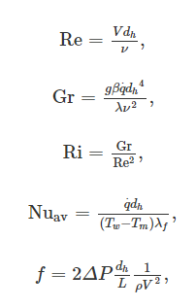
Data Reduction:
The dimensionless parameters of Reynolds number, Grashof number, Richardson number, Nusselt number and friction factor are considered for the data reduction and they are expressed by the following relations:
Where V is average inlet velocity, q is heat flux, Tw and Tm represents the average surface temperature and bulk fluid temperature, respectively

Slide 19
Material Properties of Particles:
Here we are using three nanoparticles infused in base fluid water, those are Aluminum oxide, titanium oxide and silicon oxide. There respective material properties are shown below:
Material | Density[kg/m3] | Specific Heat[J/Kg.K] | Volumetric Expansion Coefficient[1/K] | Dynamic Viscosity[Pa.s] | Thermal conductivity[W/m.K]
Al₂O₃ | 3880 | 773 | // | // | 36
Water | 998.2 | 4182 | 2.10e-4 | 993e-6 | 0.597
Table-2: Aluminum oxide Material properties at T=293 K.

Slide 20
Material Properties of Particles:
Material | Density[kg/m3] | Specific Heat[J/Kg.K] | Volumetric Expansion Coefficient[1/K] | Dynamic Viscosity[Pa.s] | Thermal conductivity[W/m.K]
TiO₂ | 4250 | 686.2 | 2.6e-8 | // | 8.9
Water | 998.2 | 4182 | 2.10e-4 | 993e-6 | 0.597
Table-3: Titanium oxide Material properties at T=293 K.
Material | Density[kg/m3] | Specific Heat[J/Kg.K] | Volumetric Expansion Coefficient[1/K] | Dynamic Viscosity[Pa.s] | Thermal conductivity[W/m.K]
SiO₂ | 2220 | 745 | 4e-6 | // | 10.4
Water | 998.2 | 4182 | 2.10e-4 | 993e-6 | 0.597
Table-4: Silicon oxide Material properties at T=293 K.

Slide 21
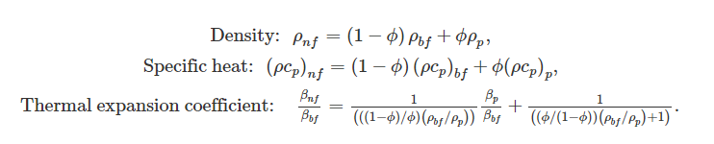
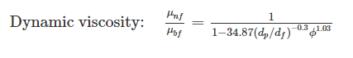
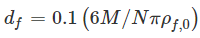
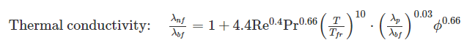
Correlations formulas varying by volumetric concentrations:
With in which M is the molecular weight of the base fluid, N is the Avogadro number, and ρ_{f,0} is the mass density of the base fluid calculated at T = 293 K

Slide 22
Thermo-Physical Properties of Nanofluids:
Here we are using water based Aluminum oxide, Titanium oxide and Silicon oxide nanofluids. There respective Thermo-Physical properties are shown below:
Volume concentration | Density[kg/m3] | Specific Heat[J/Kg.K] | Volumetric Expansion Coefficient[1/K] | Dynamic Viscosity[Pa.s] | Thermal conductivity[W/m.K]
0% | 998.2 | 4182 | 2.1e-4 | 993e-6 | 0.597
1% | 1027 | 4053 | 2.098e-4 | 1082e-6 | 0.622
2% | 1056 | 3931 | 2.095e-4 | 1193e-6 | 0.636
4% | 1113 | 3707 | 2.09e-4 | 1511e-6 | 0.658
Table-5: Water based Aluminum oxide Nanofluid Thermo-physical properties at T=293 K.

Slide 23
Volume concentration | Density[kg/m3] | Specific Heat[J/Kg.K] | Volumetric Expansion Coefficient[1/K] | Dynamic Viscosity[Pa.s] | Thermal conductivity[W/m.K]
0% | 998.2 | 4182 | 2.1e-4 | 993e-6 | 0.597
1% | 1030.718 | 4037.85631 | 2.095e-4 | 1035.68e-6 | 0.59847
2% | 1063.236 | 3902.5296 | 2.09e-4 | 1084.24e-6 | 0.59932
4% | 1128.272 | 3655.2772 | 2.0798e-4 | 1199.06e-6 | 0.60067
Table-6: Water based Titanium oxide Nanofluid Thermo-physical properties at T=293 K.
Volume concentration | Density[kg/m3] | Specific Heat[J/Kg.K] | Volumetric Expansion Coefficient[1/K] | Dynamic Viscosity[Pa.s] | Thermal conductivity[W/m.K]
0% | 998.2 | 4182 | 2.1e-4 | 993e-6 | 0.597
1% | 1010.418 | 4106.48532 | 2.0914e-4 | 1018.47e-6 | 0.600717
2% | 1022.636 | 4032.77505 | 2.0827e-4 | 1045.23e-6 | 0.60287
4% | 1047.072 | 3890.51517 | 2.0650e-4 | 1102.62e-6 | 0.60628
Table-7: Water based Silicon oxide Nanofluid Thermo-physical properties at T=293 K.

Slide 24
Results and Discussion:
Results are obtained for 3 different nanofluids and we considered Reynolds number as constant value 100, Richardson number varying as 0.1, 0.5, 1, 2, 3, 5, and 0%, 1%, 2%, 4% volume concentrations.
Results are reported in terms of average convective heat transfer coefficient, average Nusselt number, wall shear stress and required pumping power profiles.
The above result profiles are considered for varying volume concentrations and for 3 different nanofluids.

Slide 25
Various profiles for Water based Aluminum-oxide Nanofluid

Slide 26
Heat Transfer Coefficient for different Richardson numbers and different volume concentration values:
RI | Heat transfer coefficient for 0% | Heat transfer coefficient for 1% | Heat transfer coefficient for 2% | Heat transfer coefficient for 4%
0.1 | 5.448133 | 6.313574 | 7.354223 | 10.66781
0.5 | 21.25401 | 24.13026 | 27.49459 | 37.61598
1 | 34.20216 | 38.32862 | 43.09314 | 57.02608
2 | 50.52384 | 55.85764 | 61.9484 | 79.28623
3 | 60.97899 | 66.90591 | 73.63438 | 92.51907
5 | 74.30826 | 80.81237 | 88.13717 | 108.3699
Table-8: Heat transfer coefficient values for volume concentrations 0%, 1%, 2%, 4% and for Richardson number varying from 0.1 to 5
Graph-2: Richardson number vs average heat transfer coefficient values for different volume concentrations.

Slide 27
Nusselt Numbers for different Richardson numbers and different volume concentration values:
RI | Nusselt numbers for 0% | Nusselt numbers for 1% | Nusselt numbers for 2% | Nusselt numbers for 4%
0.1 | 0.091258509 | 0.101504405 | 0.118235096 | 0.162124772
0.5 | 0.356013568 | 0.387946302 | 0.442035209 | 0.571671429
1 | 0.572900503 | 0.616215756 | 0.692815756 | 0.866657751
2 | 0.846295477 | 0.898032797 | 0.995954984 | 1.204957903
3 | 1.021423618 | 1.075657717 | 1.183832476 | 1.406064894
5 | 1.244694472 | 1.299234244 | 1.416996302 | 1.646958967
Table-9: Nusselt Number values for volume concentrations 0%, 1%, 2%, 4% and for Richardson number varying from 0.1 to 5
Graph-3: Richardson Number vs Nusselt Number values for different volume concentrations.

Slide 28
Average Shear stresses for different Richardson numbers and different volume concentration values:
RI | Avg shear stress for 0% | Avg shear stress for 1% | Avg shear stress for 2% | Avg shear stress for 4%
0.1 | 0.006635436 | 0.00761144 | 0.008943619 | 0.01345261
0.5 | 0.006806649 | 0.007800849 | 0.009149997 | 0.01370168
1 | 0.007022164 | 0.008039304 | 0.009411325 | 0.01402205
2 | 0.007462541 | 0.008532352 | 0.009957971 | 0.01470695
3 | 0.00791004 | 0.009037794 | 0.01052422 | 0.01543468
5 | 0.008801587 | 0.01005109 | 0.01167057 | 0.01694618
Table-10: Average Shear Stress values for volume concentrations 0%, 1%, 2%, 4% and for Richardson number varying from 0.1 to 5
Graph-4: Richardson Number vs average Shear Stress values for different volume concentrations.

Slide 29
Heat Transfer Coefficient in wall-1 for different Richardson numbers and different volume concentration values:
RI | heat transfer coefficient in wall1 for 0% | heat transfer coefficient in wall1 for 1% | heat transfer coefficient in wall1 for 2% | heat transfer coefficient in wall1 for 4%
0.1 | 5.5320113 | 6.419944 | 7.4921297 | 10.932921
0.5 | 22.653324 | 25.855989 | 29.661206 | 41.379692
1 | 37.677835 | 42.50302 | 48.186551 | 65.240079
2 | 57.567447 | 64.091134 | 71.705004 | 93.902767
3 | 70.73386 | 78.135024 | 86.719146 | 111.32035
5 | 87.913914 | 96.183623 | 105.67565 | 132.3072
Table-11: Heat Transfer coefficient in wall-1 for volume concentrations 0%, 1%, 2%, 4% and for Richardson number varying from 0.1 to 5
Graph-5: Richardson Number vs Heat transfer coefficient values in wall-1 for different volume concentrations.

Slide 30
Heat Transfer Coefficient in wall-2 & wall-3 for different Richardson numbers and different volume concentration values:
RI | Heat transfer coefficient in wall2&3 for 0% | Heat transfer coefficient in wall2&3 for 1% | Heat transfer coefficient in wall2&3 for 2% | Heat transfer coefficient in wall2&3 for 4%
0.1 | 5.4061941 | 6.2603895 | 7.28526985 | 10.5352615
0.5 | 20.554355 | 23.2673955 | 26.4112815 | 35.7341205
1 | 32.464316 | 36.241416 | 40.5464375 | 52.9190835
2 | 47.002039 | 51.74089 | 57.070094 | 71.9779645
3 | 56.101561 | 61.2913465 | 67.0920035 | 83.1184305
5 | 67.505434 | 73.1267465 | 79.367929 | 96.4012035
Table-12: Heat Transfer coefficient in wall-1 for volume concentrations 0%, 1%, 2%, 4% and for Richardson number varying from 0.1 to 5
Graph-6: Richardson Number vs Heat transfer coefficient values in wall-1 for different volume concentrations.

Slide 31
Pumping Power for different Richardson numbers and different volume concentration values:
RI | Pumping power at 0% | Pumping power at 1% | Pumping power at 2% | Pumping power at 4%
0.1 | 0.05292 | 0.06452 | 0.08159 | 0.14848
0.5 | 0.05357 | 0.065301 | 0.08252 | 0.1499
1 | 0.051746 | 0.06621 | 0.08359 | 0.15152
2 | 0.05317 | 0.067987 | 0.08569 | 0.15459
3 | 0.05729 | 0.069717 | 0.08775 | 0.1577
5 | 0.06001 | 0.072973 | 0.0917 | 0.16385
Table-13: Pumping Power for volume concentrations 0%, 1%, 2%, 4% and for Richardson number varying from 0.1 to 5
Graph-7: Richardson Number vs Pumping Power for different volume concentrations.

Slide 32
Various profiles for Water based Titanium-oxide Nanofluid

Slide 33
Heat Transfer Coefficient for different Richardson numbers and different volume concentration values:
RI | Heat transfer coefficient for 0% | Heat transfer coefficient for 1% | Heat transfer coefficient for 2% | Heat transfer coefficient for 4%
0.1 | 5.448133 | 5.577328 | 5.753989 | 6.257199
0.5 | 21.25401 | 21.67906 | 22.26189 | 23.91099
1 | 34.20216 | 34.80476 | 35.63537 | 37.98203
2 | 50.52384 | 51.28837 | 52.35074 | 55.35499
3 | 60.97899 | 61.81585 | 62.98681 | 66.2996
5 | 74.30826 | 75.20524 | 76.47026 | 80.05796
Table-14: Heat transfer coefficient values for volume concentrations 0%, 1%, 2%, 4% and for Richardson number varying from 0.1 to 5
Graph-8: Richardson number vs average heat transfer coefficient values for different volume concentrations.

Slide 34
Nusselt Numbers for different Richardson numbers and different volume concentration values:
RI | Nusselt numbers for 0% | Nusselt numbers for 1% | Nusselt numbers for 2% | Nusselt numbers for 4%
0.1 | 0.091258509 | 0.093193109 | 0.096008626 | 0.104170326
0.5 | 0.356013568 | 0.362241382 | 0.371452479 | 0.398071986
1 | 0.572900503 | 0.581562317 | 0.59459671 | 0.632327734
2 | 0.846295477 | 0.856991495 | 0.873502303 | 0.921554098
3 | 1.021423618 | 1.032898057 | 1.050971267 | 1.1037608
5 | 1.244694472 | 1.256625061 | 1.27595041 | 1.332811028
Table-15: Nusselt Number values for volume concentrations 0%, 1%, 2%, 4% and for Richardson number varying from 0.1 to 5
Graph-9: Richardson Number vs Nusselt Number values for different volume concentrations.

Slide 35
Average Shear stresses for different Richardson numbers and different volume concentration values:
RI | Avg shear stress for 0% | Avg shear stress for 1% | Avg shear stress for 2% | Avg shear stress for 4%
0.1 | 0.006635436 | 0.006982479 | 0.007405428 | 0.008497297
0.5 | 0.006806649 | 0.007160908 | 0.007592003 | 0.008701053
1 | 0.007022164 | 0.007385595 | 0.00782645 | 0.008957443
2 | 0.007462541 | 0.007846044 | 0.008308489 | 0.009488493
3 | 0.00791004 | 0.008314665 | 0.008800392 | 0.01003425
5 | 0.008801587 | 0.009249688 | 0.009783857 | 0.0111324
Table-16: Average Shear Stress values for volume concentrations 0%, 1%, 2%, 4% and for Richardson number varying from 0.1 to 5
Graph-10: Richardson Number vs average Shear Stress values for different volume concentrations.

Slide 36
Heat Transfer Coefficient in wall-1 for different Richardson numbers and different volume concentration values:
RI | heat transfer coefficient in wall1 for 0% | heat transfer coefficient in wall1 for 1% | heat transfer coefficient in wall1 for 2% | heat transfer coefficient in wall1 for 4%
0.1 | 5.5320113 | 5.6647126 | 5.8463562 | 6.3645057
0.5 | 22.653324 | 23.129902 | 23.786262 | 25.652297
1 | 37.677835 | 38.391023 | 39.379487 | 42.188062
2 | 57.567447 | 58.519547 | 59.850805 | 63.634657
3 | 70.73386 | 71.801522 | 73.303747 | 77.573664
5 | 87.913914 | 89.082635 | 90.738138 | 95.447136
Table-17: Heat Transfer coefficient in wall-1 for volume concentrations 0%, 1%, 2%, 4% and for Richardson number varying from 0.1 to 5
Graph-11: Richardson Number vs Heat transfer coefficient values in wall-1 for different volume concentrations.

Slide 37
Heat Transfer Coefficient in wall-2 & wall-3 for different Richardson numbers and different volume concentration values:
RI | Heat transfer coefficient in wall2&3 for 0% | Heat transfer coefficient in wall2&3 for 1% | Heat transfer coefficient in wall2&3 for 2% | Heat transfer coefficient in wall2&3 for 4%
0.1 | 5.4061941 | 5.5193447 | 5.7078057 | 6.203545
0.5 | 20.554355 | 20.953641 | 21.4997045 | 23.0403335
1 | 32.464316 | 33.011628 | 33.763307 | 35.8790175
2 | 47.002039 | 47.672787 | 48.6007 | 51.2151545
3 | 56.101561 | 56.823019 | 57.8283345 | 60.662575
5 | 67.505434 | 68.2665465 | 69.3363225 | 72.3633715
Table-18: Heat Transfer coefficient in wall-1 for volume concentrations 0%, 1%, 2%, 4% and for Richardson number varying from 0.1 to 5
Graph-12: Richardson Number vs Heat transfer coefficient values in wall-1 for different volume concentrations.

Slide 38
Pumping Power for different Richardson numbers and different volume concentration values:
RI | Pumping power at 0% | Pumping power at 1% | Pumping power at 2% | Pumping power at 4%
0.1 | 0.05292 | 0.005630361 | 0.06066018 | 0.072724258
0.5 | 0.05357 | 0.005698122 | 0.061388957 | 0.073563423
1 | 0.051746 | 0.005779651 | 0.062250151 | 0.07454637
2 | 0.05317 | 0.005938741 | 0.063912462 | 0.076445961
3 | 0.05729 | 0.006088043 | 0.065528715 | 0.078310652
5 | 0.06001 | 0.006373642 | 0.068573117 | 0.081840453
Table-19: Pumping Power for volume concentrations 0%, 1%, 2%, 4% and for Richardson number varying from 0.1 to 5
Graph-13: Richardson Number vs Pumping Power for different volume concentrations.

Slide 39
Various profiles for Water based Silicon-oxide Nanofluid

Slide 40
Heat Transfer Coefficient for different Richardson numbers and different volume concentration values:
RI | Heat transfer coefficient for 0% | Heat transfer coefficient for 1% | Heat transfer coefficient for 2% | Heat transfer coefficient for 4%
0.1 | 5.448133 | 5.637946 | 5.82733 | 6.239723
0.5 | 21.25401 | 21.87005 | 22.47911 | 23.78937
1 | 34.20216 | 35.06477 | 35.91391 | 37.72988
2 | 50.52384 | 51.59975 | 52.65425 | 54.89887
3 | 60.97899 | 62.14434 | 63.28294 | 65.70034
5 | 74.30826 | 75.53662 | 76.73816 | 79.27076
Table-20: Heat transfer coefficient values for volume concentrations 0%, 1%, 2%, 4% and for Richardson number varying from 0.1 to 5
Graph-14: Richardson number vs average heat transfer coefficient values for different volume concentrations.

Slide 41
Nusselt Numbers for different Richardson numbers and different volume concentration values:
RI | Nusselt numbers for 0% | Nusselt numbers for 1% | Nusselt numbers for 2% | Nusselt numbers for 4%
0.1 | 0.091258509 | 0.093853612 | 0.096659811 | 0.102918173
0.5 | 0.356013568 | 0.364065775 | 0.37286828 | 0.392382563
1 | 0.572900503 | 0.583715294 | 0.59571566 | 0.622317741
2 | 0.846295477 | 0.858969365 | 0.873393103 | 0.905503563
3 | 1.021423618 | 1.034502769 | 1.049694627 | 1.083663324
5 | 1.244694472 | 1.257441025 | 1.272880721 | 1.307494227
Table-21: Nusselt Number values for volume concentrations 0%, 1%, 2%, 4% and for Richardson number varying from 0.1 to 5
Graph-15: Richardson Number vs Nusselt Number values for different volume concentrations.

Slide 42
Average Shear stresses for different Richardson numbers and different volume concentration values:
RI | Avg shear stress for 0% | Avg shear stress for 1% | Avg shear stress for 2% | Avg shear stress for 4%
0.1 | 0.006635436 | 0.006884893 | 0.007152599 | 0.007747661
0.5 | 0.006806649 | 0.007061313 | 0.007334041 | 0.007939174
1 | 0.007022164 | 0.007283258 | 0.007562222 | 0.008180385
2 | 0.007462541 | 0.00773852 | 0.008031791 | 0.008679793
3 | 0.00791004 | 0.008202078 | 0.008511121 | 0.00919225
5 | 0.008801587 | 0.009127057 | 0.009469252 | 0.01022107
Table-22: Average Shear Stress values for volume concentrations 0%, 1%, 2%, 4% and for Richardson number varying from 0.1 to 5
Graph-16: Richardson Number vs average Shear Stress values for different volume concentrations.

Slide 43
Heat Transfer Coefficient in wall-1 for different Richardson numbers and different volume concentration values:
RI | heat transfer coefficient in wall1 for 0% | heat transfer coefficient in wall1 for 1% | heat transfer coefficient in wall1 for 2% | heat transfer coefficient in wall1 for 4%
0.1 | 5.5320113 | 5.7268703 | 5.9215481 | 6.346065
0.5 | 22.653324 | 23.342211 | 24.027427 | 25.508665
1 | 37.677835 | 38.694647 | 39.703906 | 41.875466
2 | 57.567447 | 58.900695 | 60.220952 | 63.048881
3 | 70.73386 | 72.212635 | 73.673735 | 76.794856
5 | 87.913914 | 89.508605 | 91.083082 | 94.424542
Table-23: Heat Transfer coefficient in wall-1 for volume concentrations 0%, 1%, 2%, 4% and for Richardson number varying from 0.1 to 5
Graph-17: Richardson Number vs Heat transfer coefficient values in wall-1 for different volume concentrations.

Slide 44
Heat Transfer Coefficient in wall-2 & wall-3 for different Richardson numbers and different volume concentration values:
RI | Heat transfer coefficient in wall2&3 for 0% | Heat transfer coefficient in wall2&3 for 1% | Heat transfer coefficient in wall2&3 for 2% | Heat transfer coefficient in wall2&3 for 4%
0.1 | 5.4061941 | 5.5934836 | 5.78022065 | 5.686852125
0.5 | 20.554355 | 21.133968 | 21.7049525 | 21.41946025
1 | 32.464316 | 33.2498285 | 34.0189065 | 33.6343675
2 | 47.002039 | 47.949283 | 48.8708935 | 48.41008825
3 | 56.101561 | 57.1101885 | 58.0875355 | 57.598862
5 | 67.505434 | 68.5506225 | 69.5657015 | 69.058162
Table-24: Heat Transfer coefficient in wall-1 for volume concentrations 0%, 1%, 2%, 4% and for Richardson number varying from 0.1 to 5
Graph-18: Richardson Number vs Heat transfer coefficient values in wall-1 for different volume concentrations.

Slide 45
Pumping Power for different Richardson numbers and different volume concentration values:
RI | Pumping power at 0% | Pumping power at 1% | Pumping power at 2% | Pumping power at 4%
0.1 | 0.05292 | 0.054968859 | 0.05873573 | 0.075437484
0.5 | 0.05357 | 0.055635469 | 0.059448353 | 0.076335541
1 | 0.051746 | 0.056433805 | 0.06028911 | 0.077391692
2 | 0.05317 | 0.057967809 | 0.061914157 | 0.079431778
3 | 0.05729 | 0.059453418 | 0.063493489 | 0.081426918
5 | 0.06001 | 0.062247073 | 0.066467166 | 0.085204782
Table-25: Pumping Power for volume concentrations 0%, 1%, 2%, 4% and for Richardson number varying from 0.1 to 5
Graph-19: Richardson Number vs Pumping Power for different volume concentrations.

Slide 46
Comparing results between Nanofluids:
Graph-20: Heat transfer coefficient for various nanofluids at 1% volume concentration
Graph-21: Heat transfer coefficient for various nanofluids at 2% volume concentration

Slide 47
Comparing results between Nanofluids:
Here Aluminum oxide nanofluid has greater heat transfer coefficient than silicon oxide or titanium oxide.
Water based Silicon oxide and Titanium oxide nanofluids has almost very same thermo-physical properties difference between those values is very less.
As volume concentration increases gap between Aluminum-oxide nanofluids and silicon oxide nanofluid increasing, showing that as volume concentration is increasing, aluminum oxide is showing greater sensitivity and providing higher heat transfer coefficient.
Graph-22: Heat transfer coefficient for various nanofluids at 4% volume concentration

Slide 48
Comparing results between Nanofluids:
Graph-23: Nusselt Number for various nanofluids at 1% volume concentration
Graph-24: Nusselt Number for various nanofluids at 2% volume concentration

Slide 49
Comparing results between Nanofluids:
Here water-aluminum oxide based has higher Nusselt number among the other two nanofluids. For aluminum oxide nanofluid at 1% volume concentration Nusselt number is varying from 0 to 1.4, at 2% volume concentration Nusselt number is varying from 0 to 1.6 and at 4% volume concentration Nusselt number is varying from 0 to 1.8.
Where as for titanium and silicon oxide nanofluids has it is varying from 0 to 1.4 at all concentrations and values for both nanofluids are very close to each other.
Comparatively Silicon oxide-water based nanofluid has lower Nusselt number.
Graph-25: Nusselt Number for various nanofluids at 4% volume concentration

Slide 50
Comparing results between Nanofluids:
Graph-23: Average shear stress for various nanofluids at 1% volume concentration
Graph-24: Average shear stress for various nanofluids at 2% volume concentration

Slide 51
Comparing results between Nanofluids:
Along with heat transfer coefficient Aluminum oxide nanofluid also has higher shear stress around the walls of the duct.
As concentration increases gap between silicon oxide and titanium oxide increases and at 4% volume concentration titanium oxide has higher shear stress which is undesirable.
Silicon oxide nanofluid is giving us the very less shear stress.
Graph-25: Average shear stress for various nanofluids at 4% volume concentration

Slide 52
Comparing results between Nanofluids:
Graph-26: Pumping power for various nanofluids at 1% volume concentration
Graph-27: Pumping power for various nanofluids at 2% volume concentration

Slide 53
Comparing results between Nanofluids:
Pumping power required for Water based Aluminum oxide nanofluid is more compared to silicon oxide or titanium oxide nanofluids.
Pumping power required for Titanium oxide nanofluid is more than that required for silicon oxide nanofluid at lower volume concentrations.
As concentration increases Silicon oxide requiring more power than that of Titanium oxide nanofluid.
Graph-28: Pumping power for various nanofluids at 4% volume concentration

Slide 54
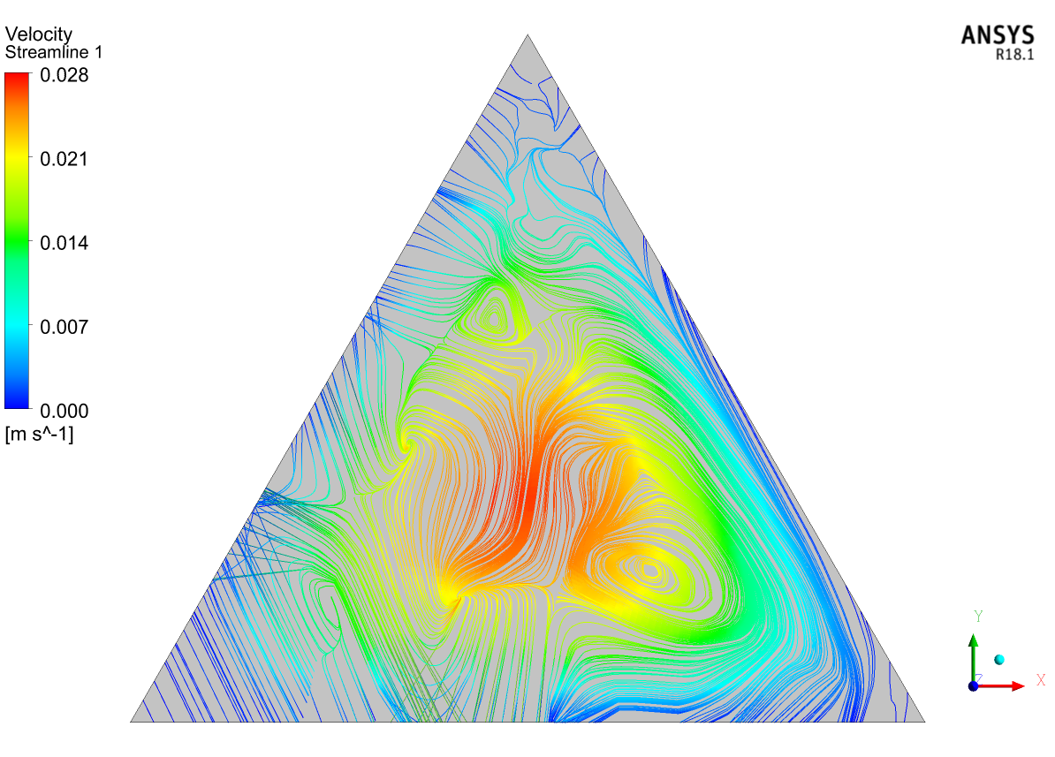
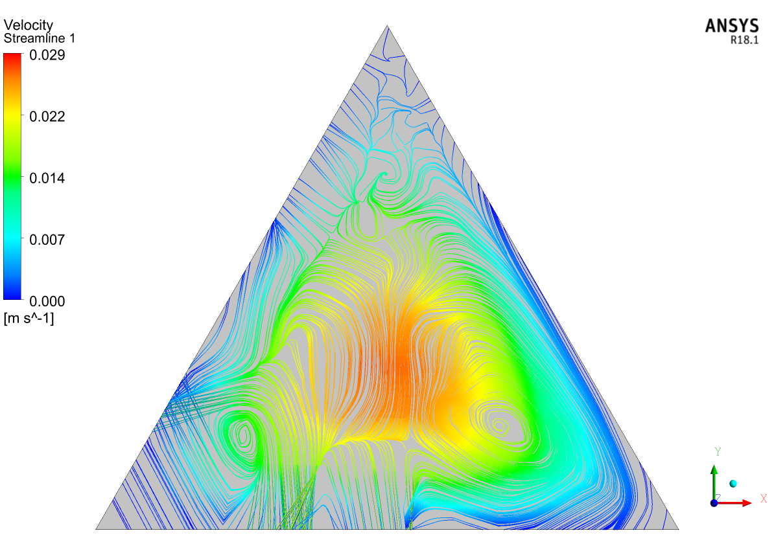
Contours of Aluminum oxide nanofluid:
Figure-2: Velocity Streamline at midpoint(1000mm) at 4% volume concentration and Richardson number=0.1
Figure-3: Velocity Streamline at midpoint(1000mm) at 4% volume concentration and Richardson number=0.5

Slide 55
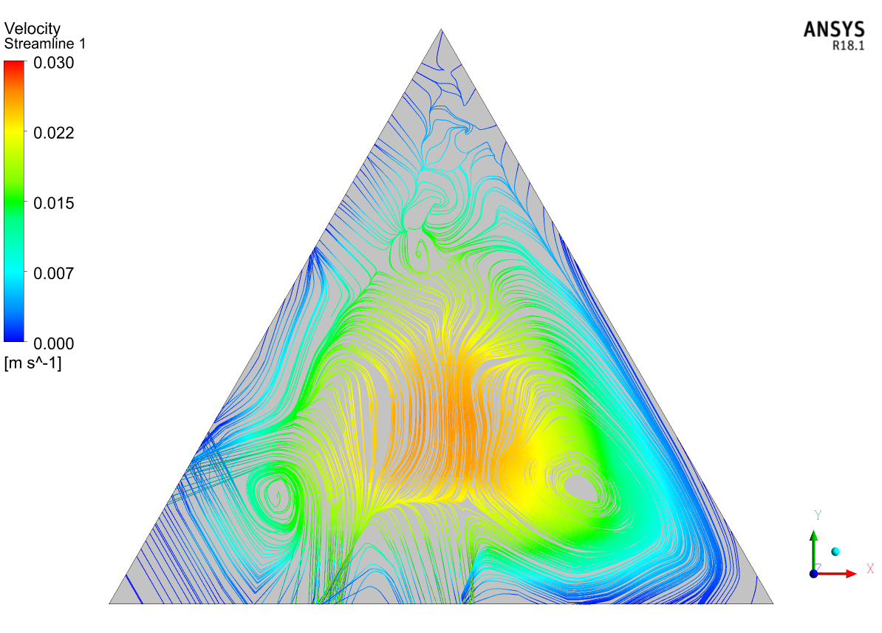
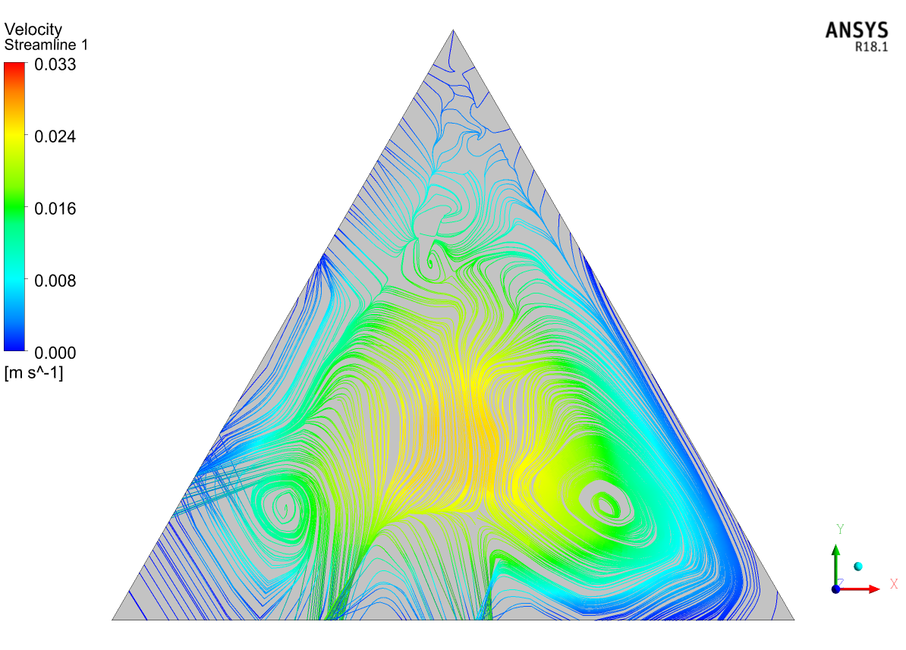
Contours of Aluminum oxide nanofluid:
Figure-4: Velocity Streamline at midpoint(1000mm) at 4% volume concentration and Richardson number=1
Figure-5: Velocity Streamline at midpoint(1000mm) at 4% volume concentration and Richardson number=2

Slide 56
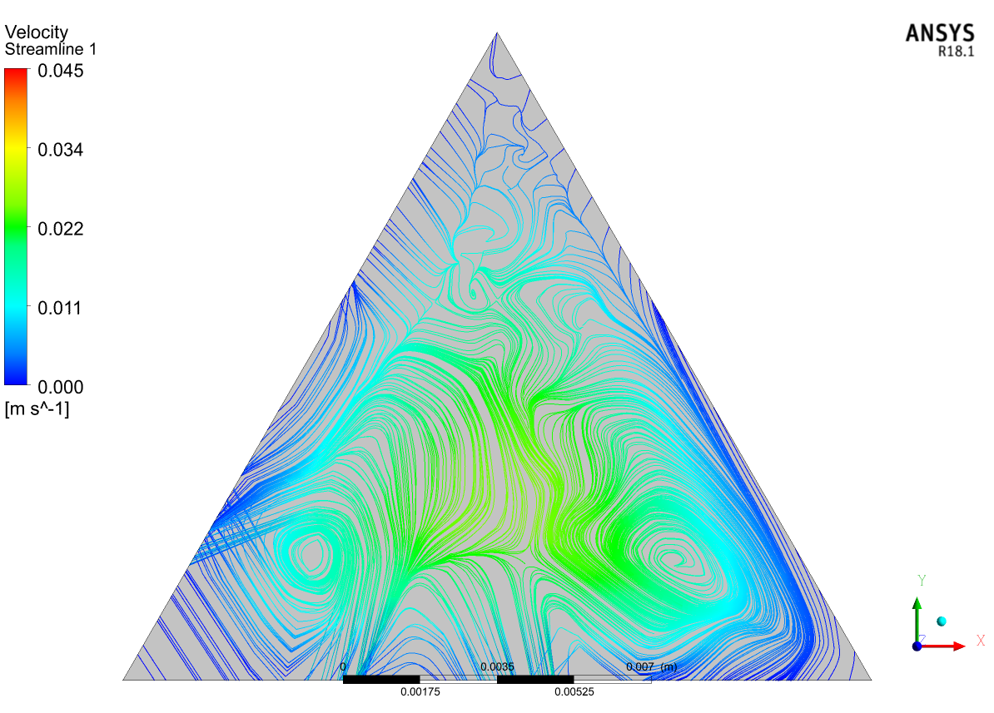
Contours of Aluminum oxide nanofluid:
Figure-6: Velocity Streamline at midpoint(1000mm) at 4% volume concentration and Richardson number=5

Slide 57
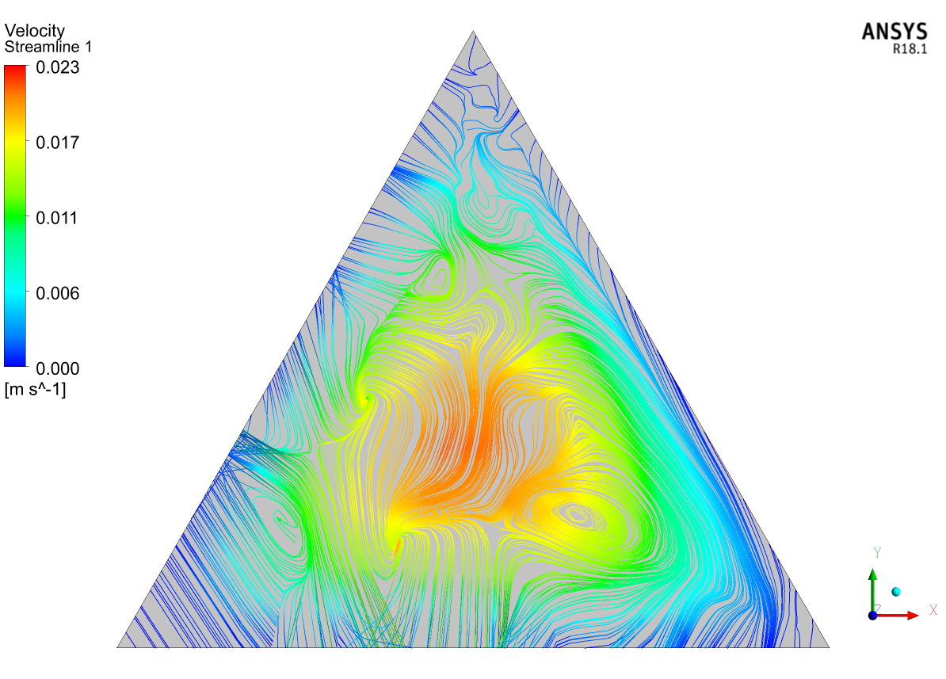
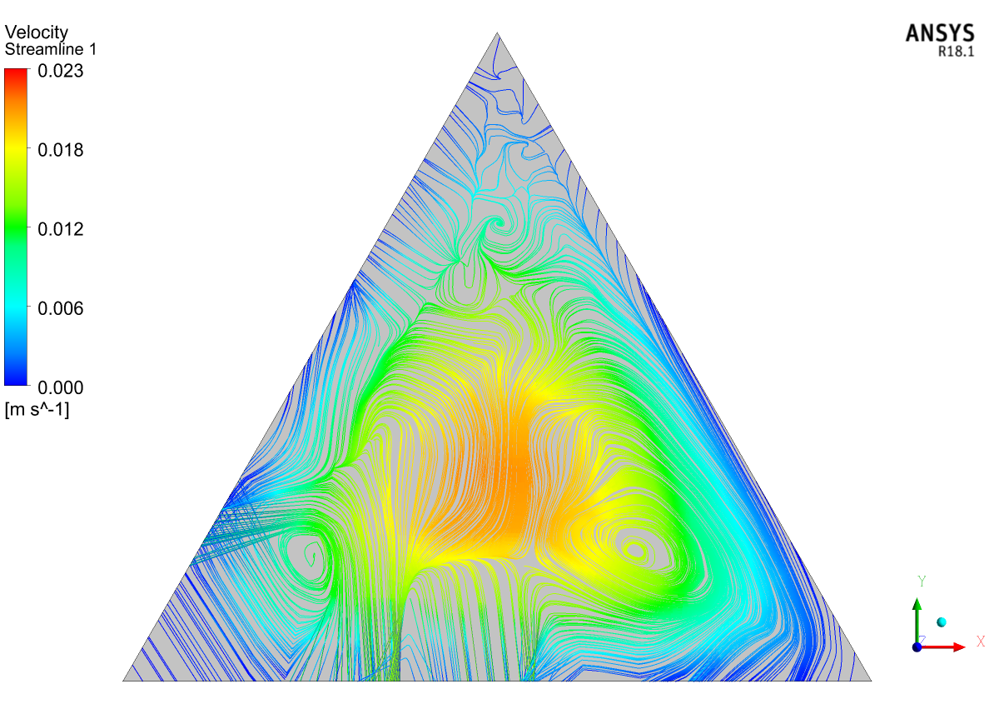
Contours of Titanium oxide nanofluid:
Figure-7: Velocity Streamline at midpoint(1000mm) at 0% volume concentration and Richardson number=0.1
Figure-8: Velocity Streamline at midpoint(1000mm) at 0% volume concentration and Richardson number=0.5

Slide 58
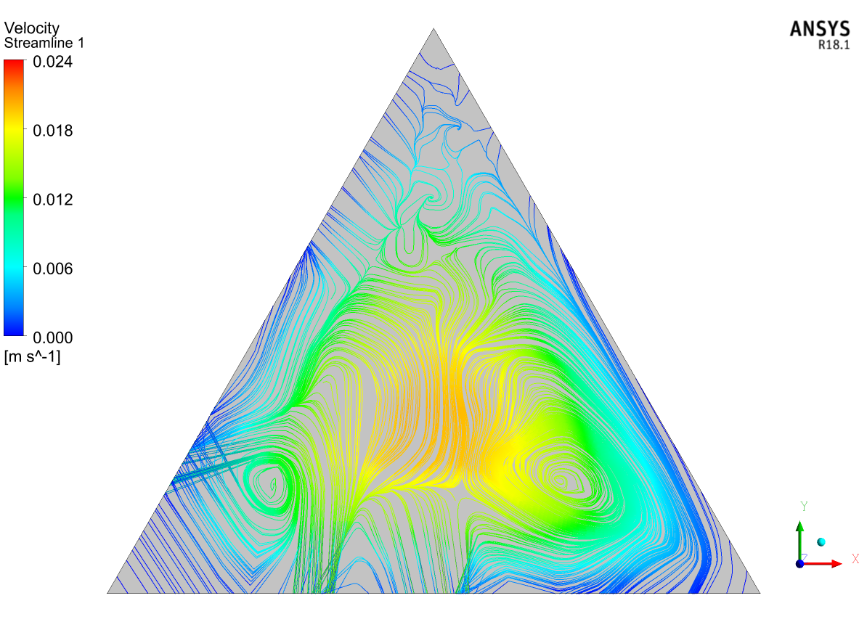
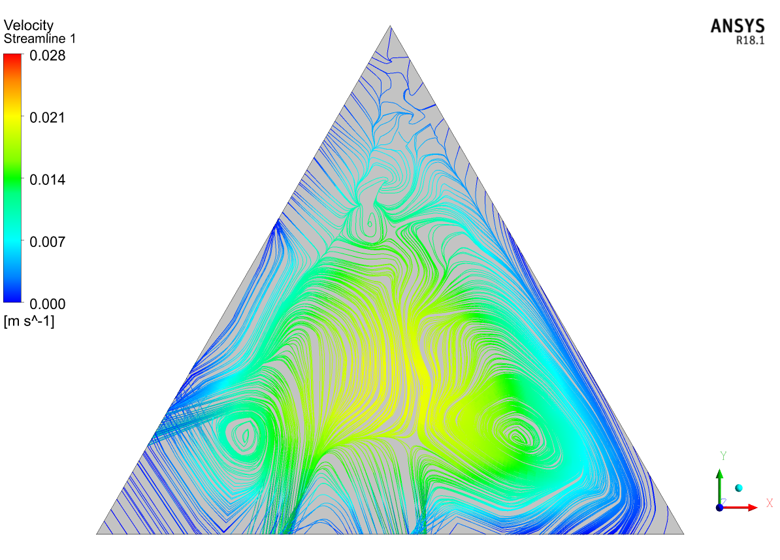
Contours of Titanium oxide nanofluid:
Figure-9: Velocity Streamline at midpoint(1000mm) at 0% volume concentration and Richardson number=1
Figure-10: Velocity Streamline at midpoint(1000mm) at 0% volume concentration and Richardson number=2

Slide 59
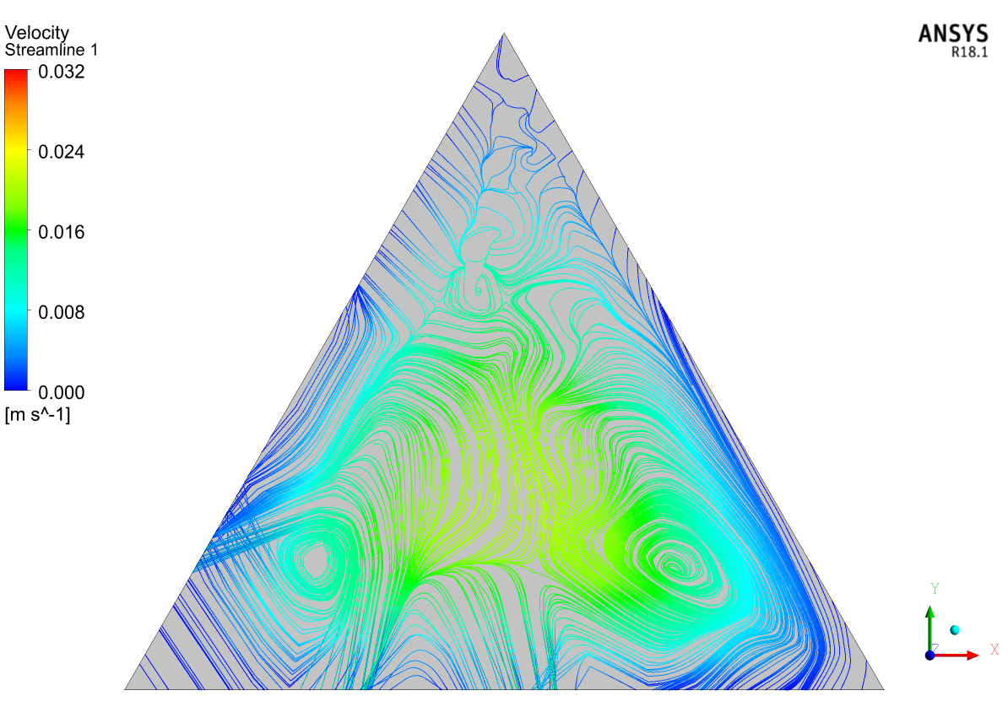
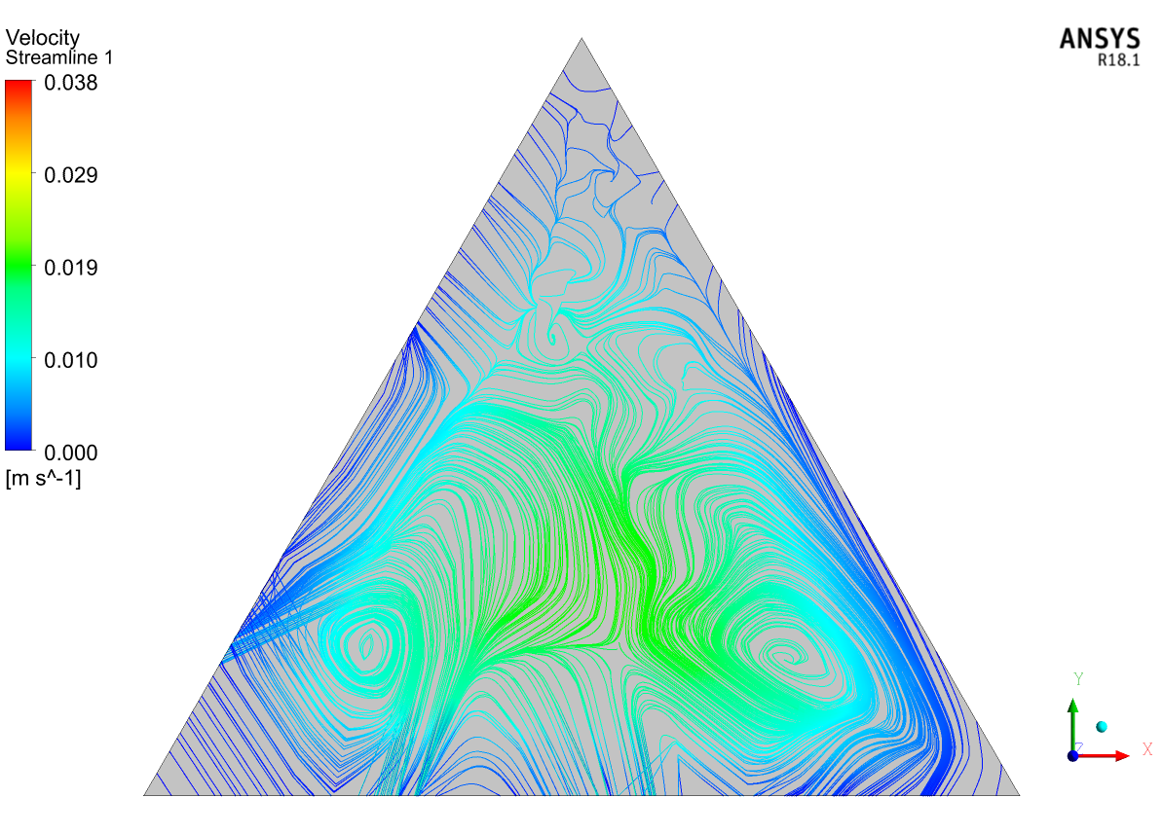
Contours of Titanium oxide nanofluid:
Figure-11: Velocity Streamline at midpoint(1000mm) at 0% volume concentration and Richardson number=3
Figure-12: Velocity Streamline at midpoint(1000mm) at 0% volume concentration and Richardson number=5

Slide 60
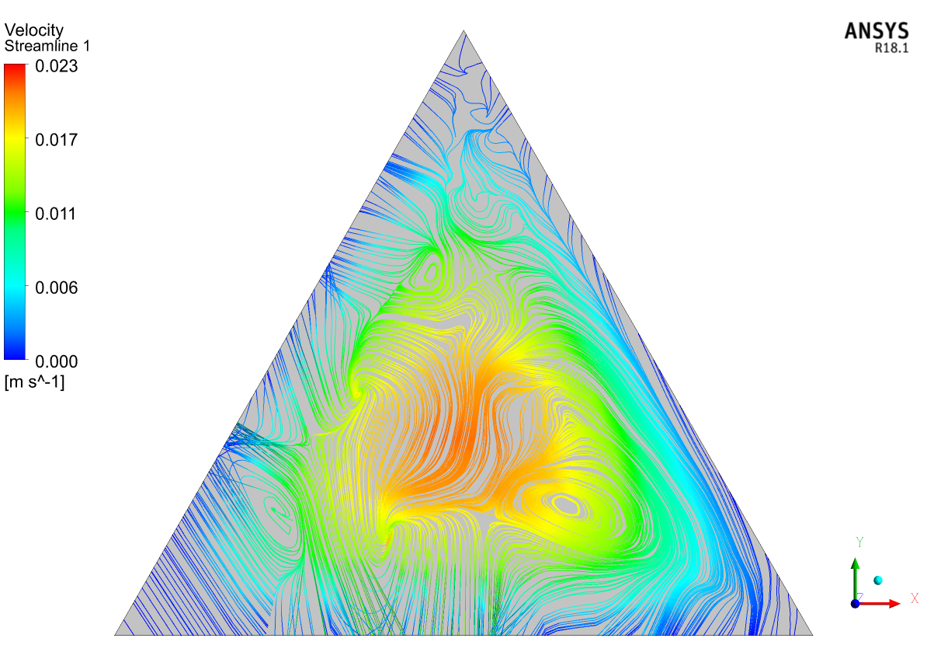

Contours of Silicon oxide nanofluid:
Figure-13: Velocity Streamline at midpoint(1000mm) at 0% volume concentration and Richardson number=0.1
Figure-14: Velocity Streamline at midpoint(1000mm) at 0% volume concentration and Richardson number=0.5

Slide 61
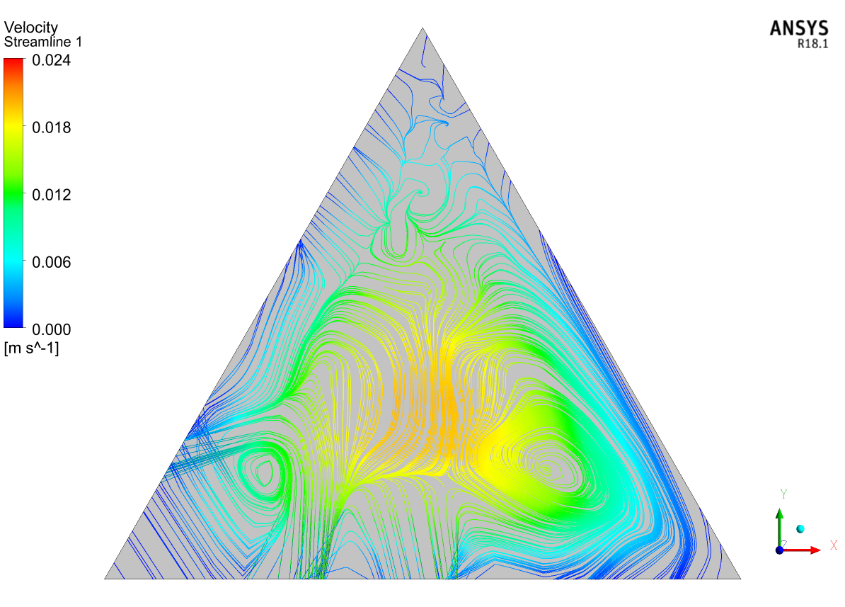
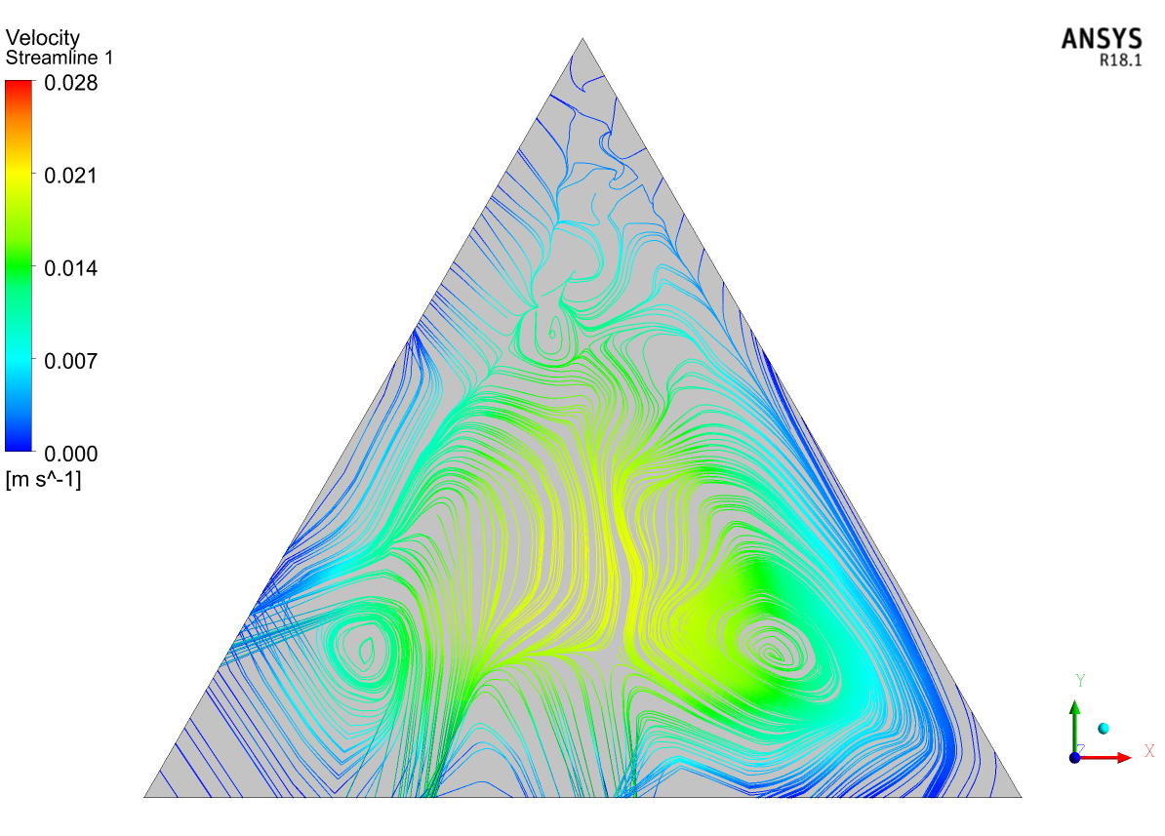
Contours of Silicon oxide nanofluid:
Figure-15: Velocity Streamline at midpoint(1000mm) at 0% volume concentration and Richardson number=1
Figure-16: Velocity Streamline at midpoint(1000mm) at 0% volume concentration and Richardson number=2

Slide 62
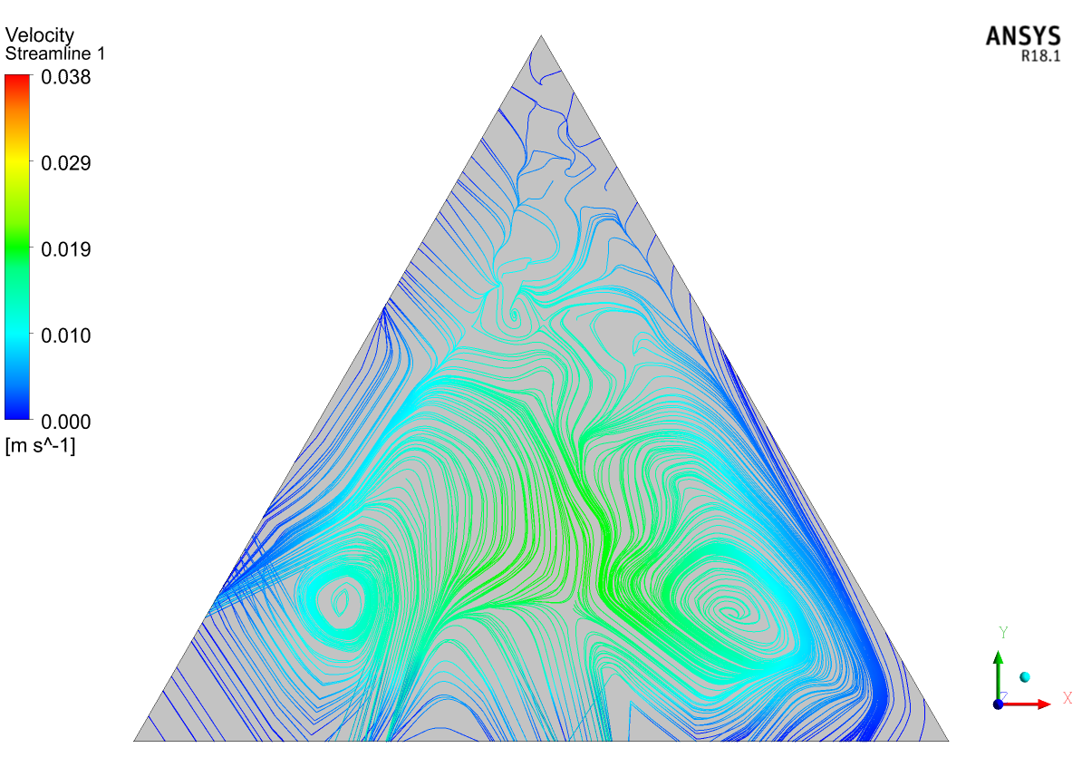
Contours of Silicon oxide nanofluid:
Figure-17: Velocity Streamline at midpoint(1000mm) at 0% volume concentration and Richardson number=5

Slide 63
Conclusions:
Water based Aluminum oxide nanofluid has higher heat transfer properties, it has greater Nusselt numbers and heat transfer coefficients. Also as Volume concentrations increasing properties are also getting improved with greater heat transfer.
The only disadvantage of using Aluminum oxide-water based nanofluid is, it requires higher pumping power and also greater shear stresses are generated along the walls.
Titanium oxide-water based nanofluid has better heat transfer capacity rather than the Silicon oxide-water based nanofluid.
But silicon oxide-water based nanofluid requires lesser pumping power and having lesser shear stresses at lower concentrations.

Slide 64
THANK YOU

